Slide 2
USHE
Uintah Basin Technical College
The mission of the Utah System of Higher Education (USHE) is to provide high quality academic, professional, and applied technology learning opportunities designed to advance the intellectual, cultural, social, and economic well-being of the state and its people. The USHE will foster a society of lifelong learners, prepare a productive work force for a knowledge-based global marketplace, cultivate social responsibility and commitment to ethical values, improve the quality and understanding of life, and promote cultural awareness and appreciation for diversity.

Slide 3
ARTICULATION AGREEMENTS
Uintah Basin Technical College
Articulation agreements can help transfer credits from one school to another, making it faster, and more cost-effective to earn a degree. They make it so students don’t have to repeat things they have already learned. One of the ways schools transfer these credits is through articulation agreements with other colleges and universities. Knowing how these agreements work can help students make sure they’re able to transfer as many credits as possible towards their degree.

Slide 4
TRANSFER CREDIT
OPPORTUNITIES
AT THESE INSTITUTIONS
Uintah Basin Technical College
UBTech Articulation Contact: Mckenzie Christensen
mckenzie@ubtech.edu | 435.722.6946

Slide 5
BUDGET STUFF
Insert Info /text here
Uintah Basin Technical College

Slide 6
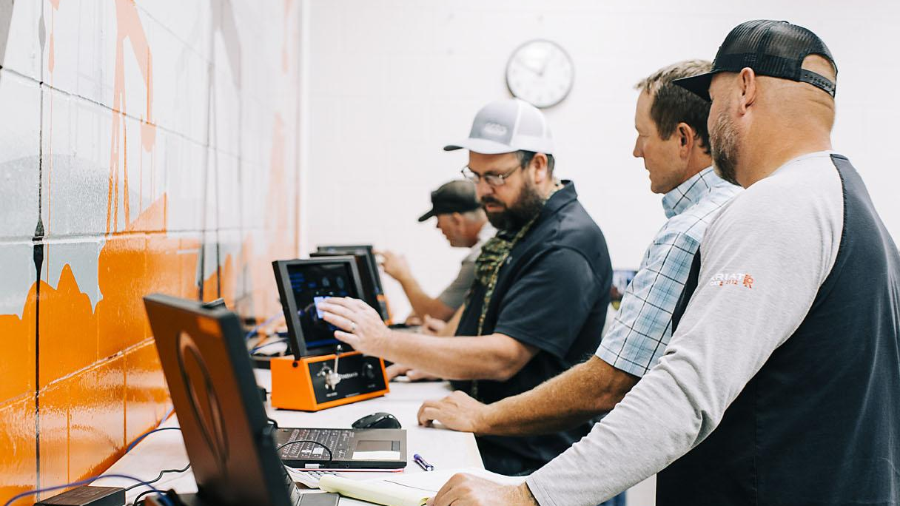
Experience
the power
of technical
education.
Uintah Basin Technical College

